Slide 1
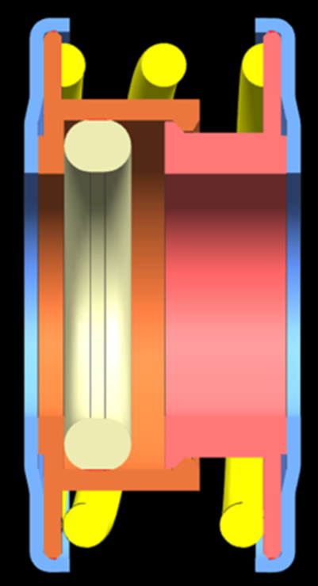
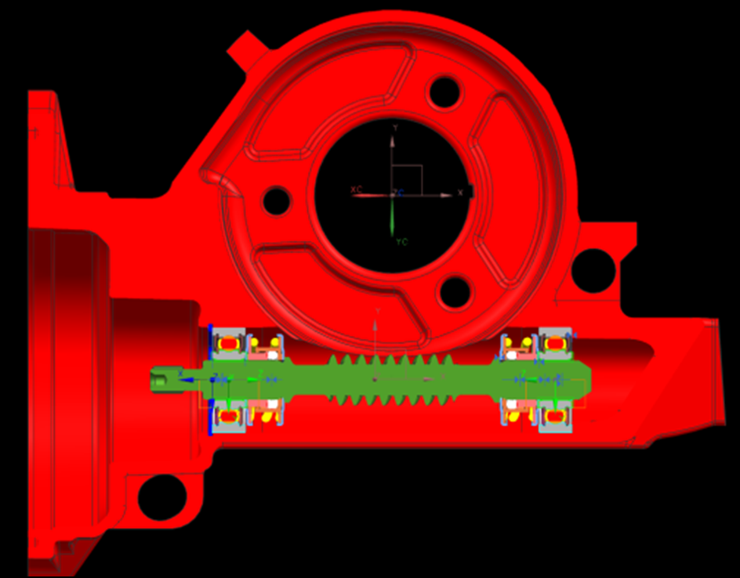
CCM-78: Spring Worm Isolators
Last updated: 01MY15
Description
Implement spring isolators for production
Motivation : 3.0
Deliverables
Fix low temperature reversal clunk issue
Improve robustness (bumper geometry change)
Timing
Quotes for new bumper geometry by mid May
Bumper geometry change prototypes by end of June
Team Members/Customers
Team names: Brad Sundholm
Customers: Application Teams

Slide 2
CCM-78: Worm Spring Isolators
Last updated: 01MY15
Status Update:
Supplier Help
Asked Parker, Freudenberg, and Mevis supplier for bumper design help
Parker and Freudenberg have proposals
Bumper Design Testing
Offset castle design
Test in vehicle at cold temp
Inner Guide Deformation Issue
Amount of overlap between components causing deformation found
Testing ongoing to prevent deformation
Thermal Testing
Calculations and Testing ongoing
Challenges:
Getting reasonable piece price for new bumper design
Vehicle and vehicle chamber availability
Determine minimum amount of overlap between components required to hold assembly together
Next Actions:
Roadmap worm axis in Fiat 500 system
Build offset castle bumpers in Haitec system
Test offset castle bumpers at cold temp in vehicle chamber

